Slide 1
In the United States, breast cancer is the most common female cancer, and the second most common cause of cancer death in women
The incidence rates are highest in North America, Australia/New Zealand, and in western and northern Europe and lowest in Asia and sub-Saharan Africa

Slide 2
The risk of breast cancer increases with older age
●Birth to age 49 – 2.0 (1 in 49 women)
●Age 50 to 59 – 2.3 (1 in 42 women)
●Age 60 to 69 – 3.5 (1 in 28 women)
●Age 70 and older – 6.7 (1 in 14 women)
●Birth to death – 12.4 (1 in 8 women)

Slide 3
Majority are diagnose with abnormal mammogram
Lump hard with irregular border
Inflammatory erythema ,Peau d Orange
Metastasis

Slide 4
●The most common breast cancer is an infiltrating ductal breast carcinoma
Other invasive breast cancers include infiltrating lobular carcinoma and mixed ductal/lobular carcinoma

Slide 5
Nipple inversion can occur with subareolar or central malignancies. The incidence of associated malignancy in patients with acquired nipple inversion ranges from 5 to 50 percent Nipple inversion associated with a malignancy tends to be asymmetric and distorts the areola

Slide 6
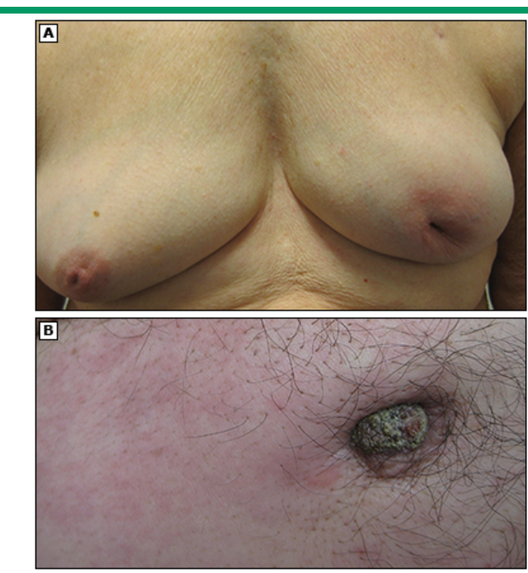

Slide 7
Patients with inflammatory breast cancer (IBC) typically present with breast pain or a rapidly growing, self-diagnosed breast lump They may also report a tender, firm, or enlarged breast, or itching of the breast
RX Chemotherapy +surgery+radiation treatment

Slide 8
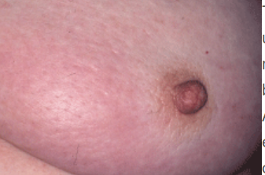
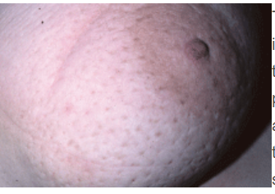

Slide 9
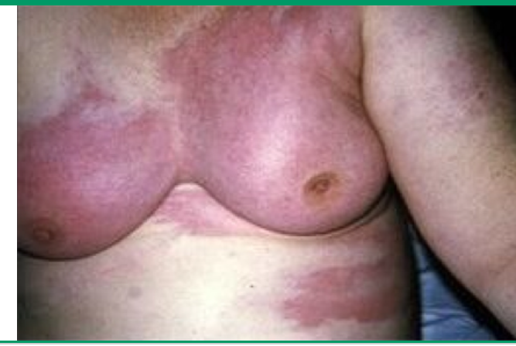

Slide 10
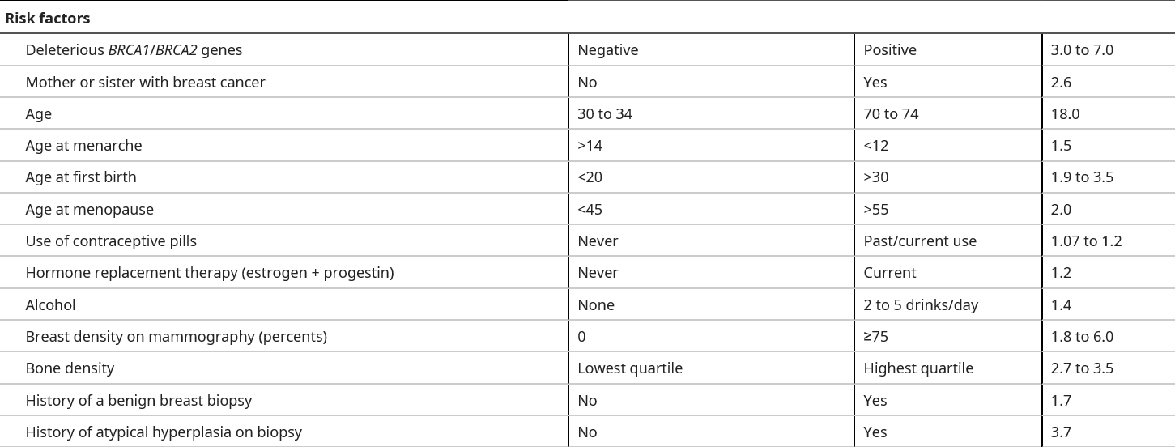

Slide 11
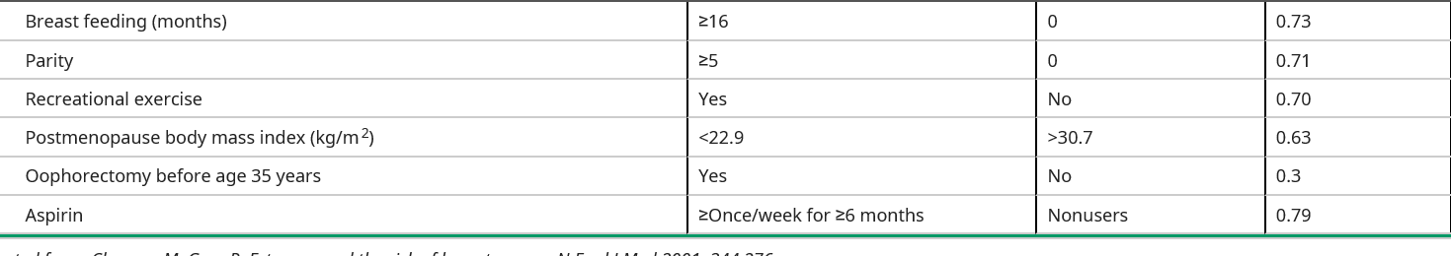
Protective factors

Slide 12
Molecular subtypes — Based on gene expression profiles
Luminal subtypes — The luminal subtypes are characterized as luminal A and luminal B ER positive.
Her 2 positive
Basal triple-negative breast

Slide 13
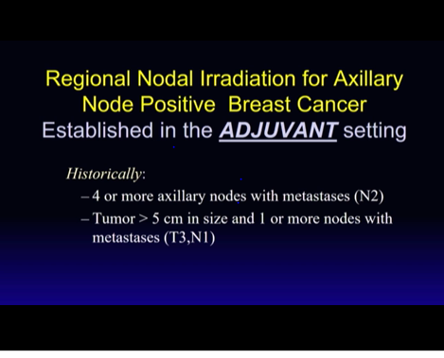

Slide 14
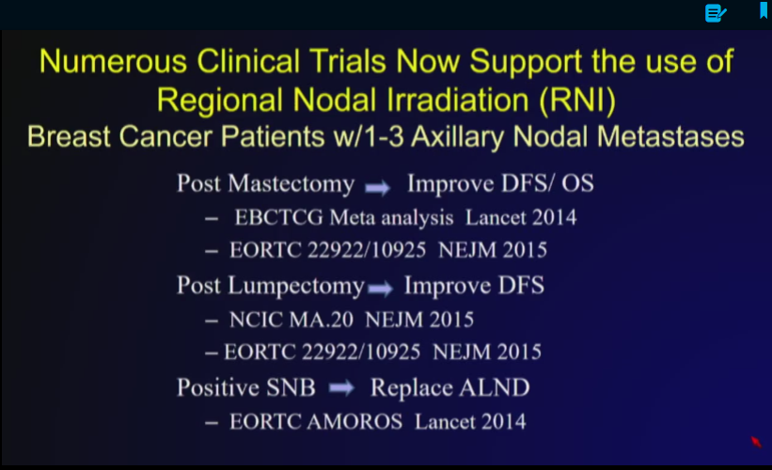

Slide 15
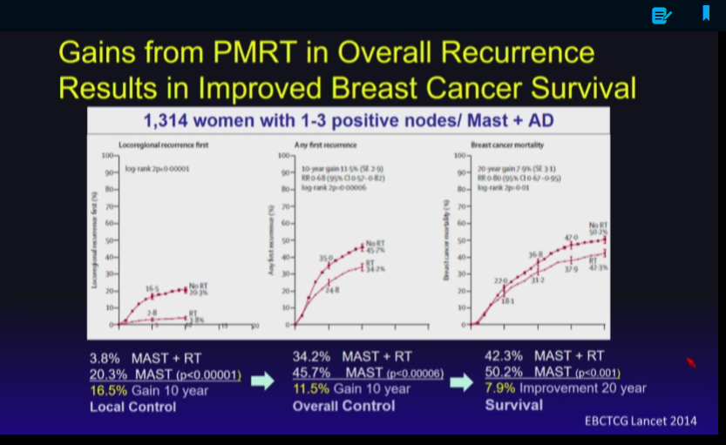

Slide 16
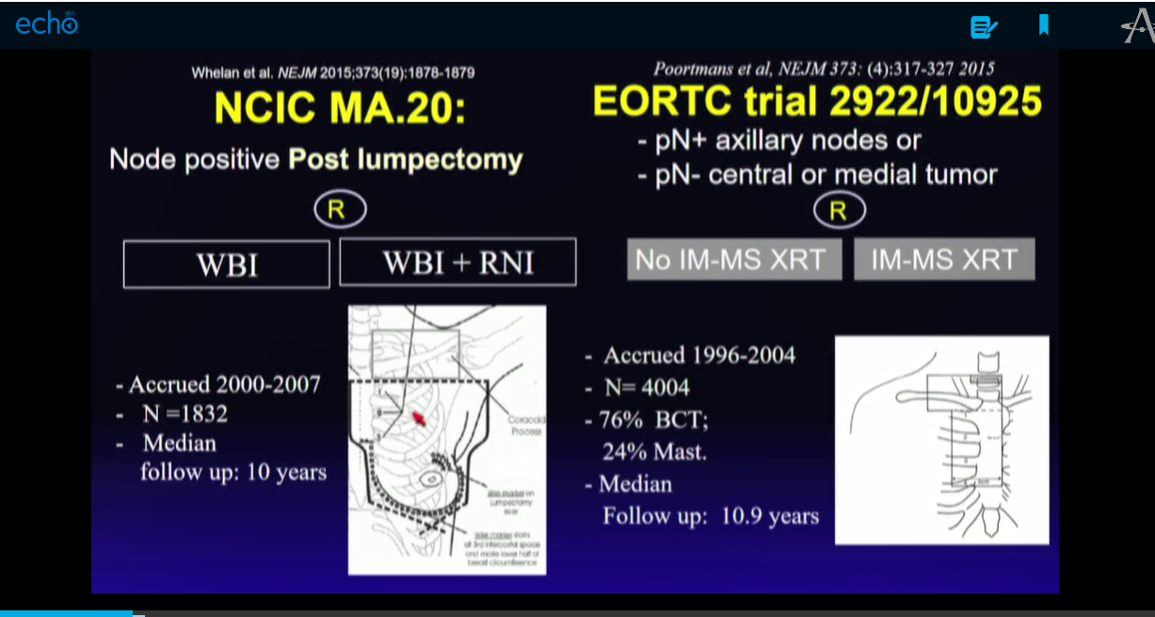

Slide 17
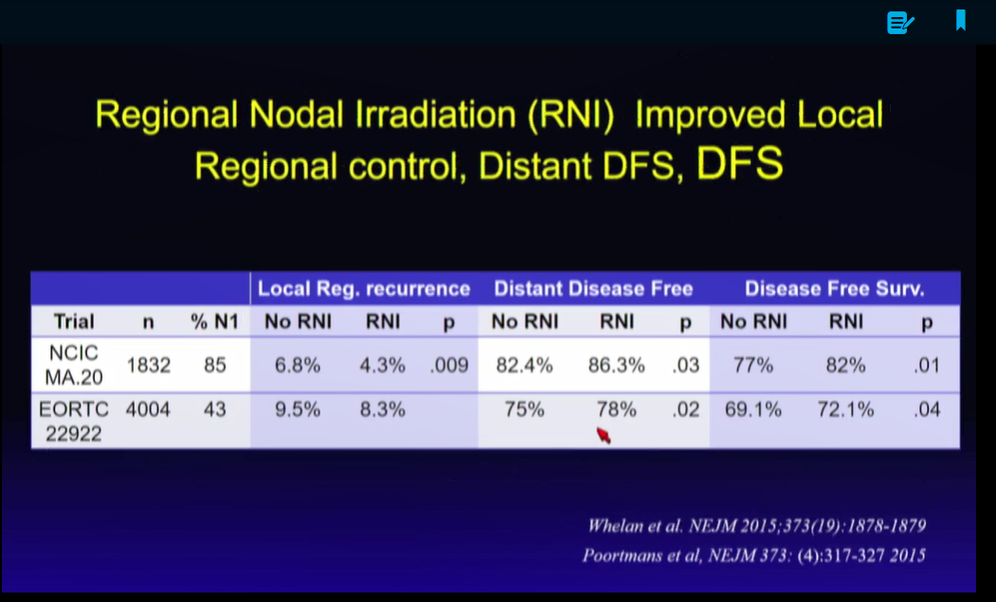

Slide 18
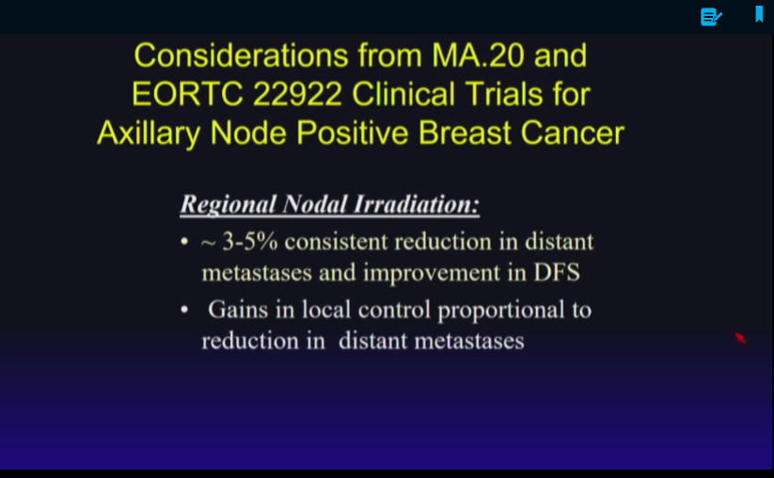

Slide 19
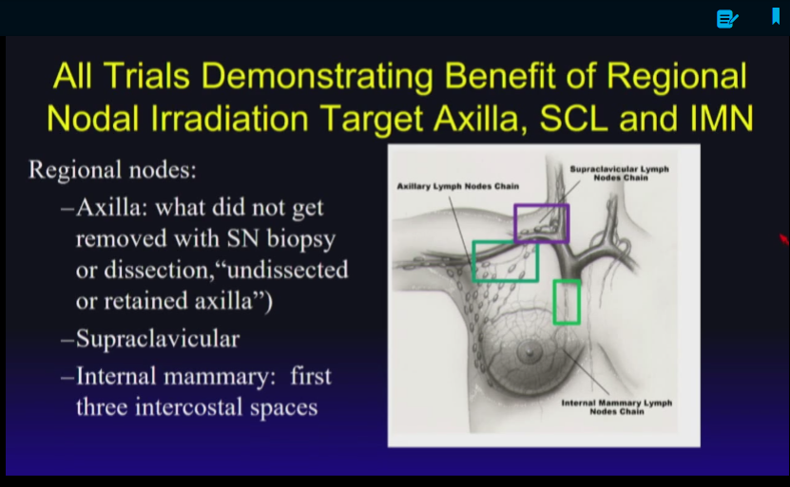

Slide 20
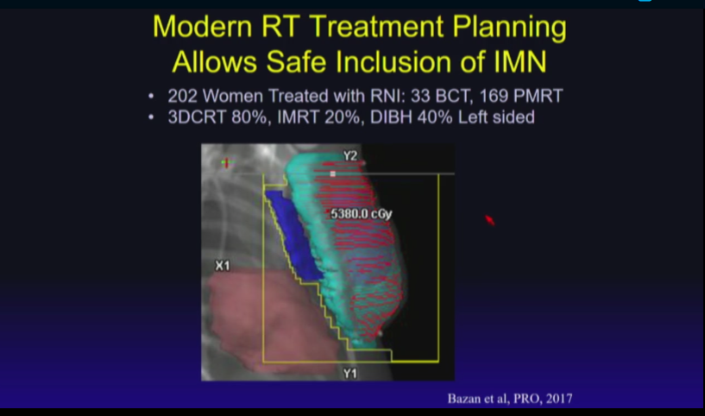

Slide 21
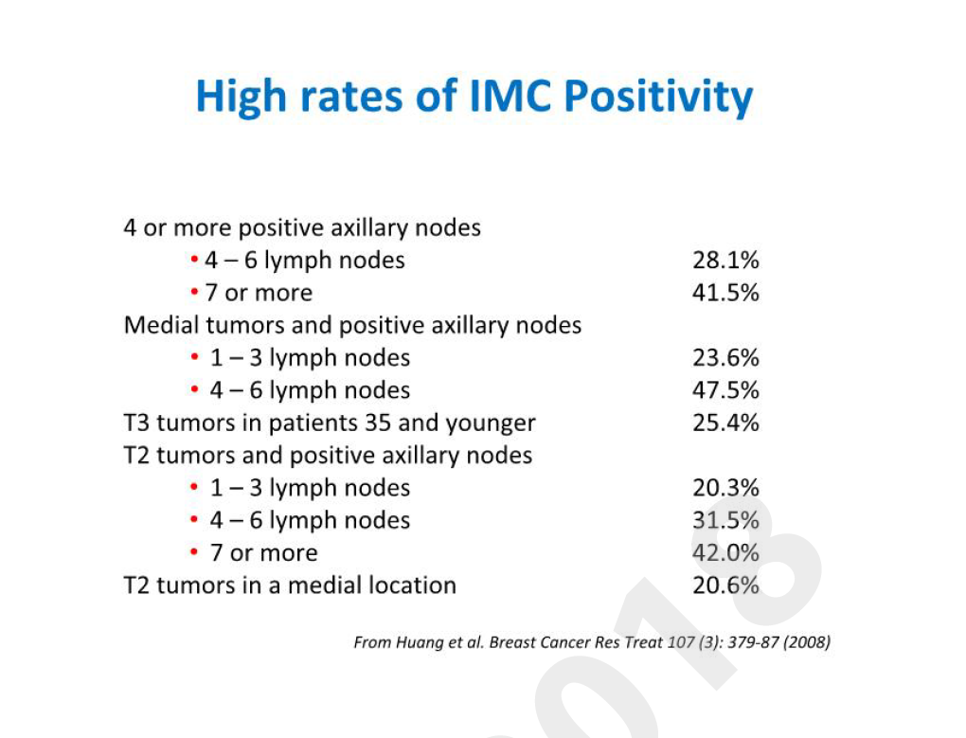

Slide 22
Fifteen-year results of the randomised EORTC trial 22922/10925 investigating internal mammary and medial supraclavicular (IM-MS) lymph node irr
adiation in stage I-III breast cancer
Philip Poortmans, Sandra Collette, Henk Struikmans, Karin De Winter, Erik Van Limbergen, Carine Kirkove, ...

Slide 23
Internal mammary and medial supraclavicular lymph node chain irradiation in stage I–III breast cancer (EORTC 22922/10925): 15-year results of a randomised, phase 3 trial Lancet Onco 2020
15 year data showed
Breast cancer recurrence reduction 24.5%Vs 27.1% (P .024)
Breast cancer Mortality 16%Vs 19.8% (p .005)
NO survival benefit.
No difference was observed in cardio vascular death .

Slide 24
Ten-Year Survival Results of a Randomized Trial of Irradiation of Internal Mammary Nodes After Mastectomy Christophe Hennequin red journal 2013
# 1334 from 1991-1997
Follow up 11.3 yrs
2 D Treatment
NO difference IMC VS no IMC
59%VS 62%

Slide 25
Critisism
1 Old trial
2 chemotherapy vs Harmone was upto treating physician
3Inclusion of node negative patints
4 2 D treatment and IMN nodes may be underdosed
5 study was designed to detect 10% survival difference which is unrealistic goal.

Slide 26
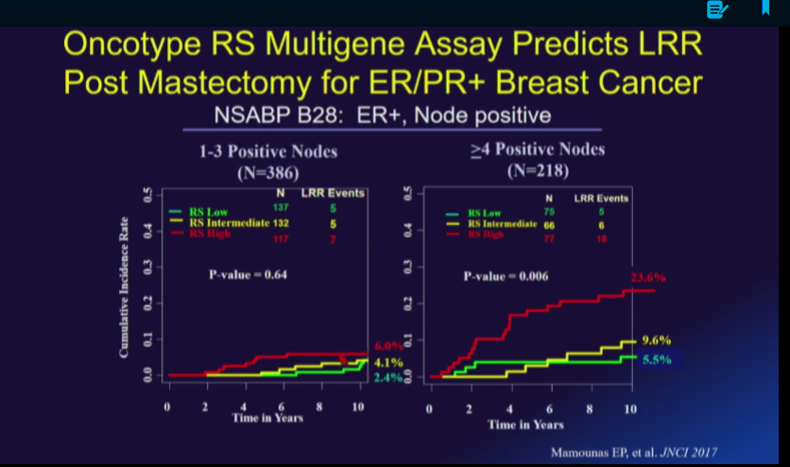

Slide 27
AMAROS Trial

Slide 28
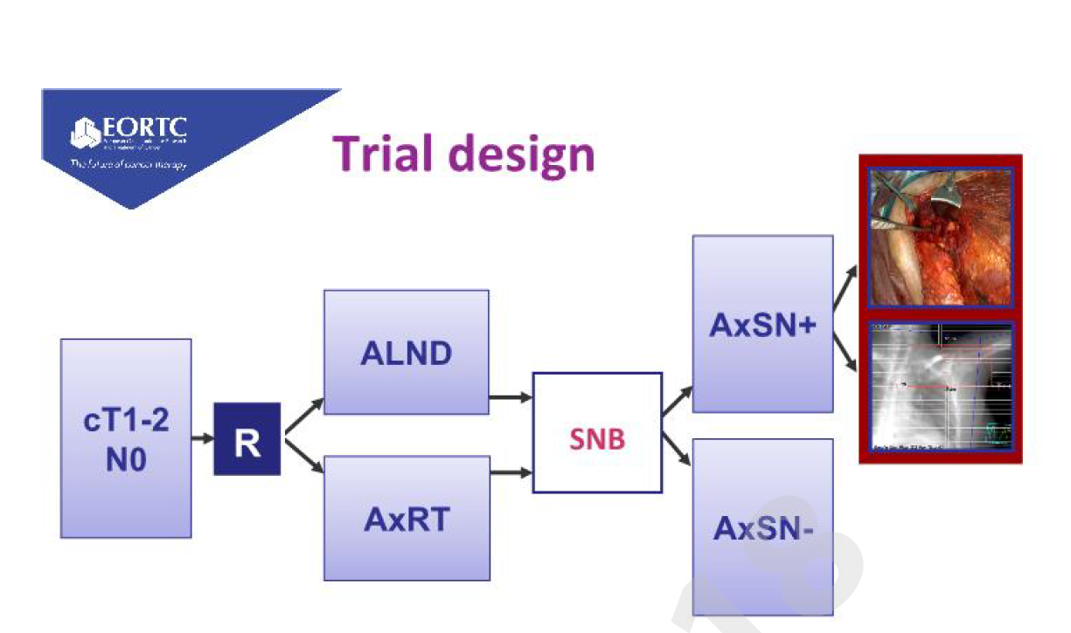

Slide 29
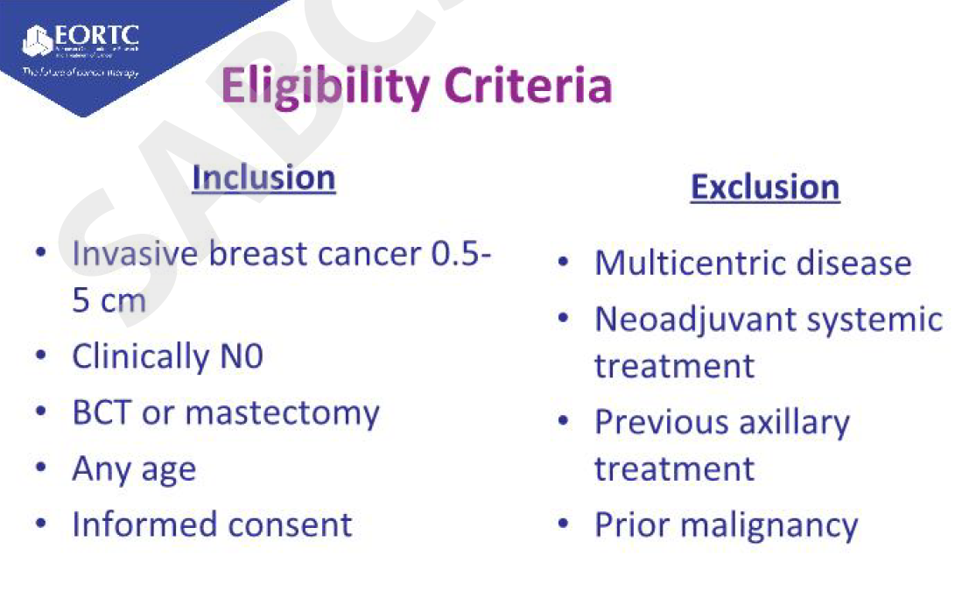

Slide 30
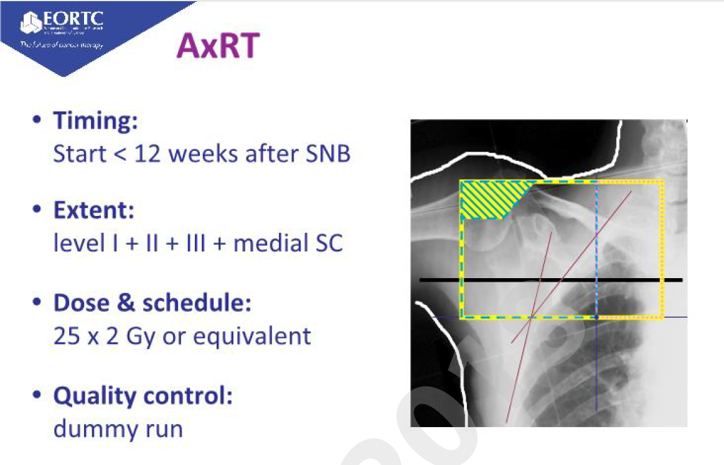

Slide 31
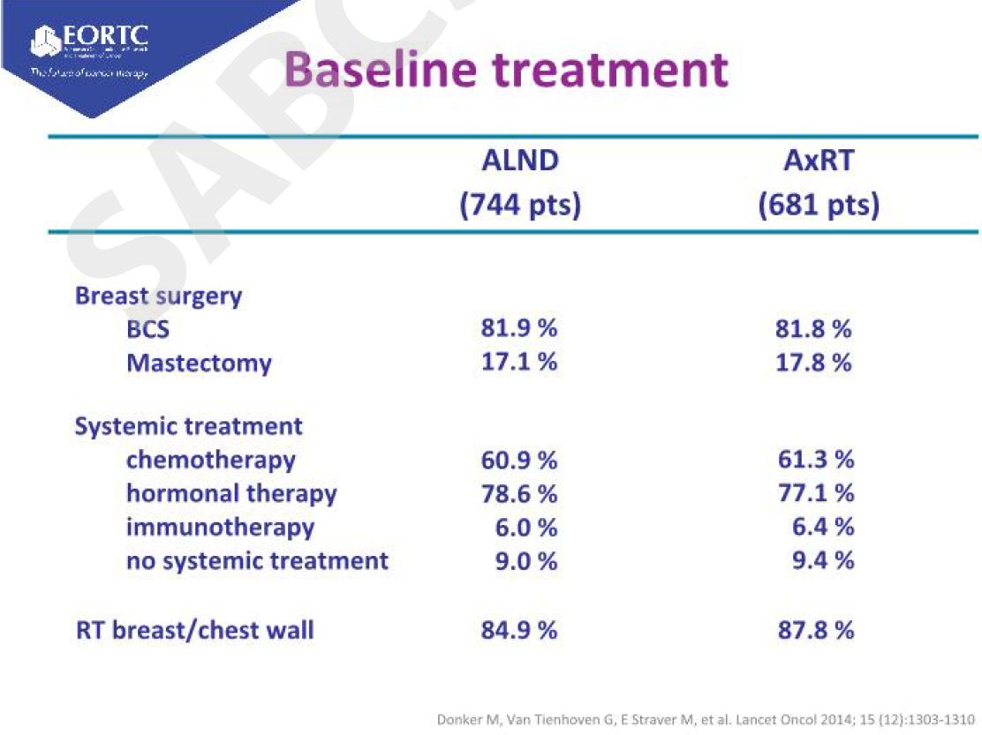

Slide 32
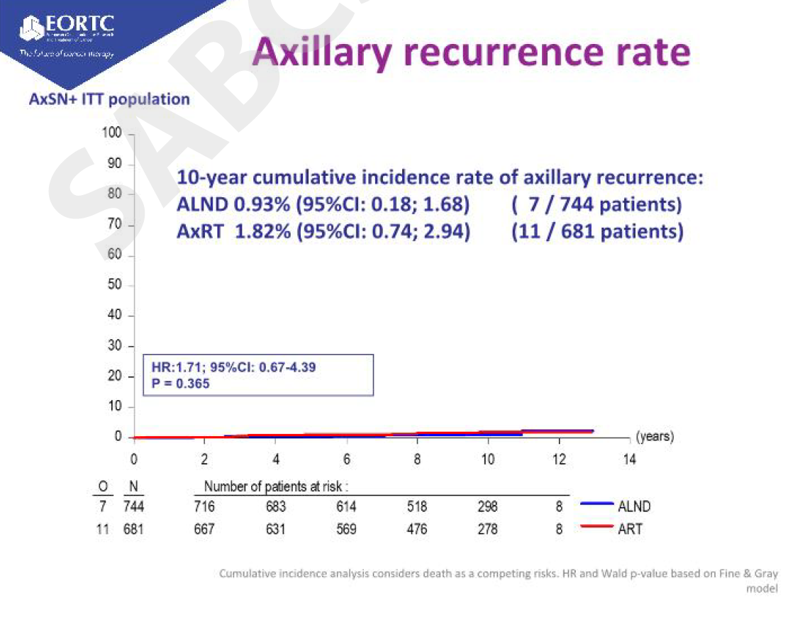

Slide 33
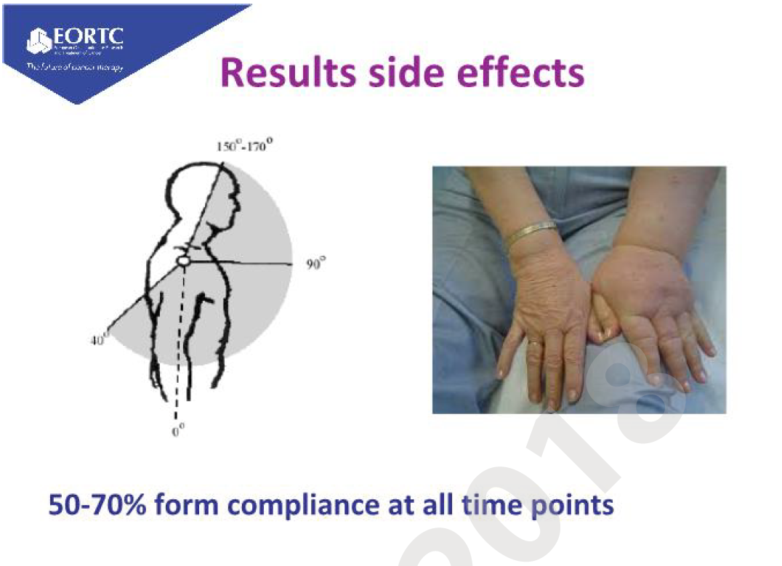

Slide 34
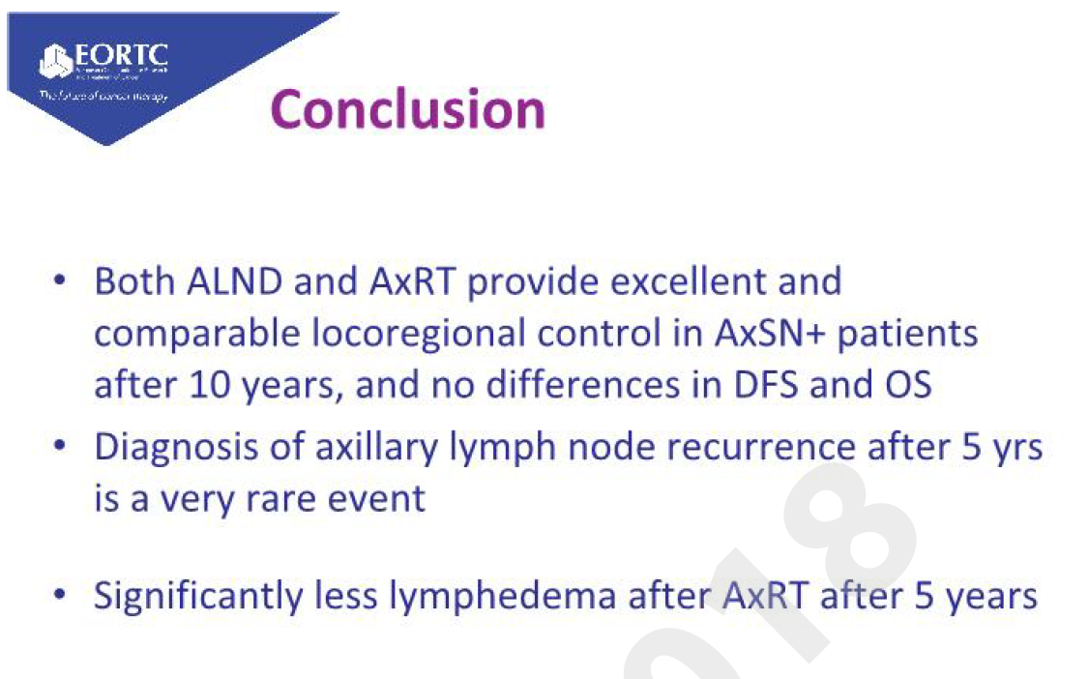

Slide 35


Slide 36
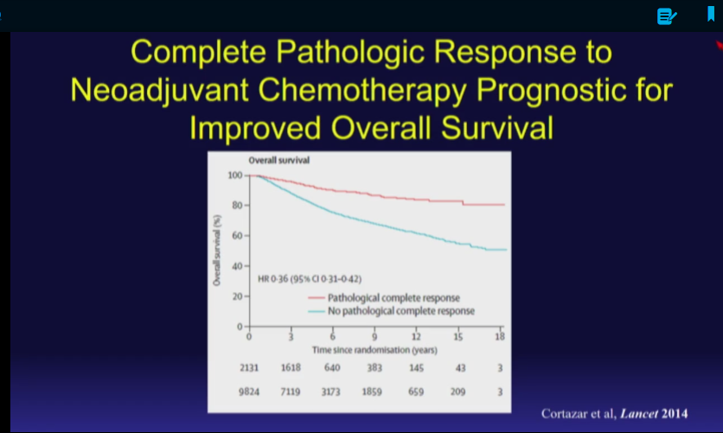

Slide 37
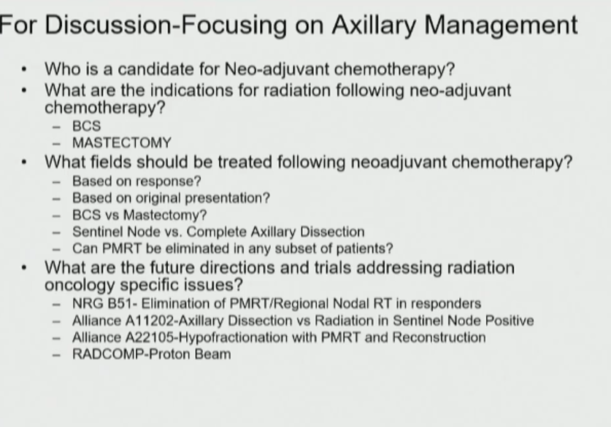

Slide 38
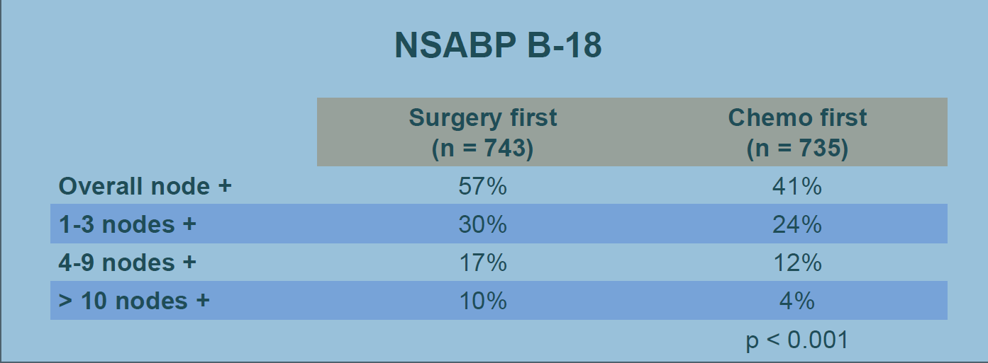
NAC Decreases Nodal metastasis

Slide 39
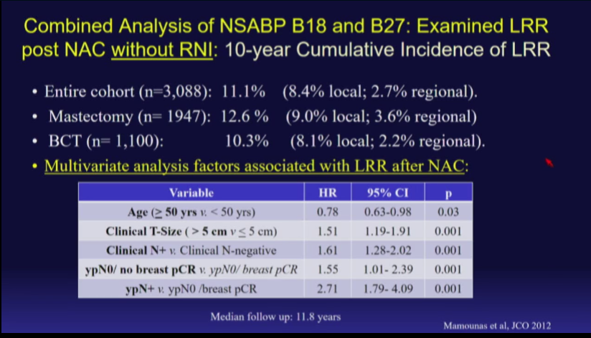

Slide 40
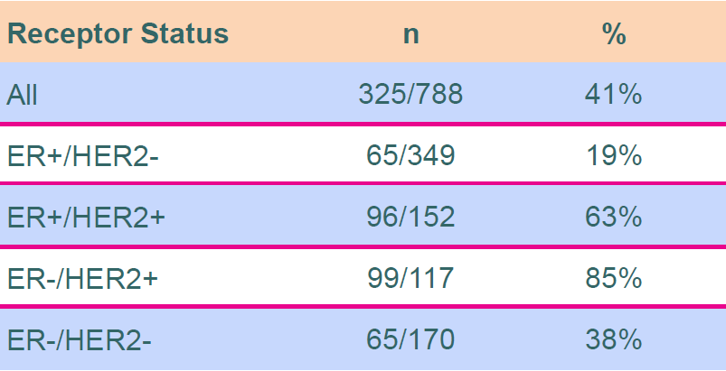
Nodal PCR by receptor

Slide 41
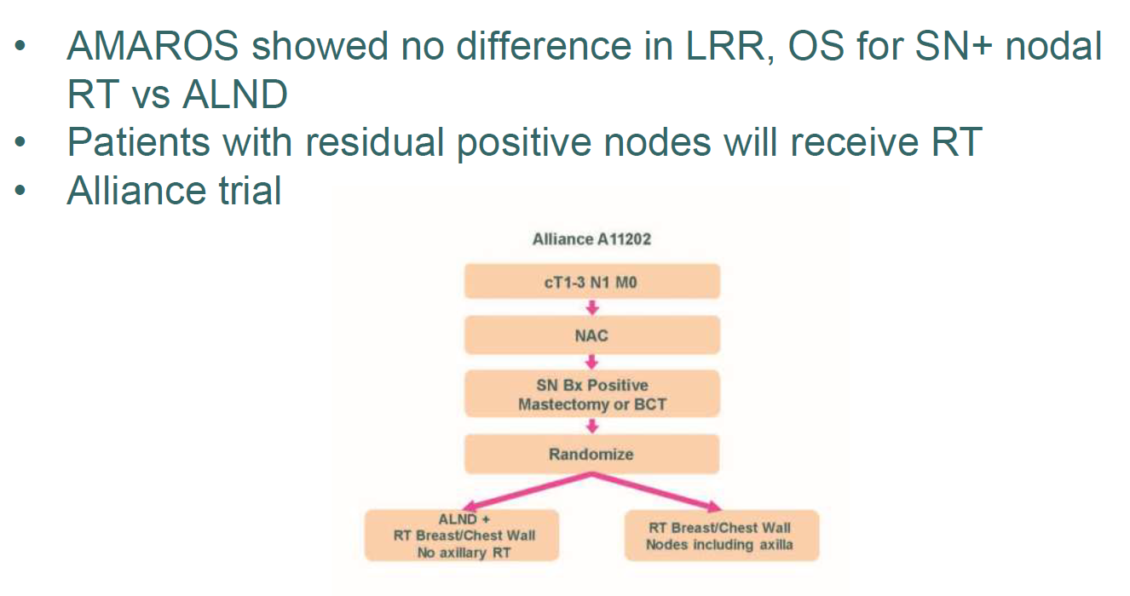
IS ALND necessary for residual N+ disease

Slide 42
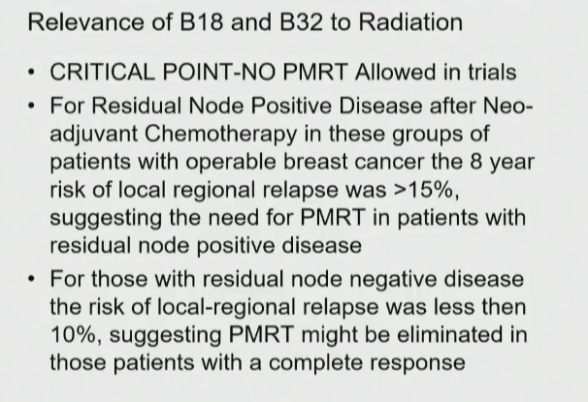

Slide 43
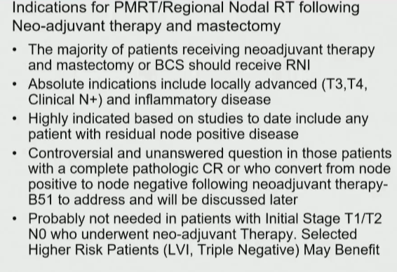

Slide 44
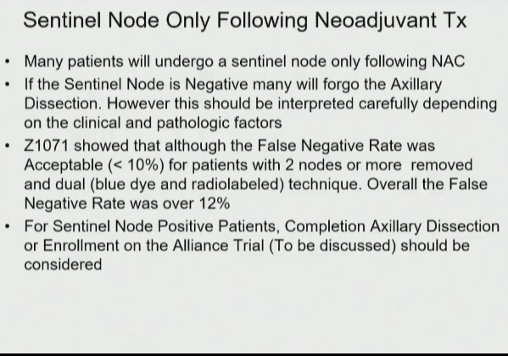

Slide 45
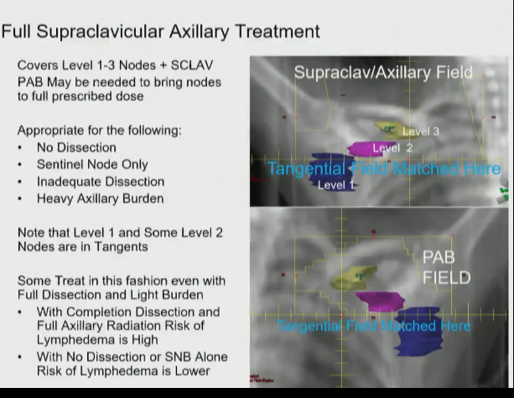

Slide 46
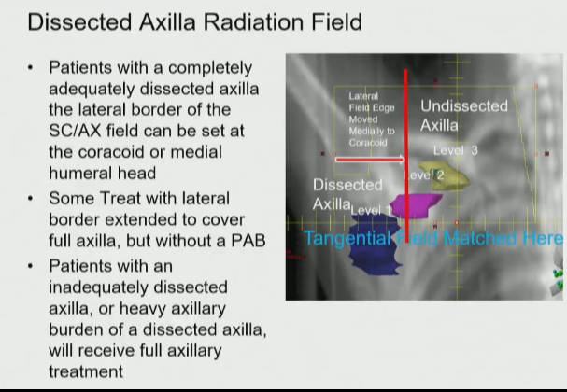

Slide 47
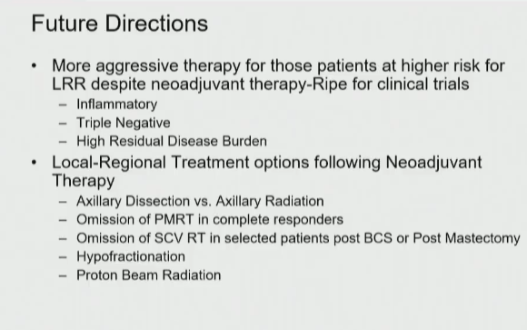

Slide 48
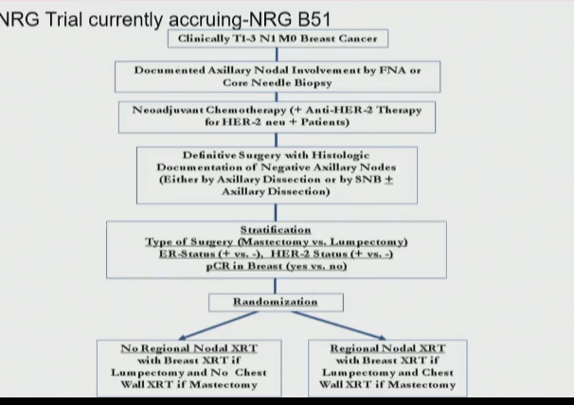

Slide 49
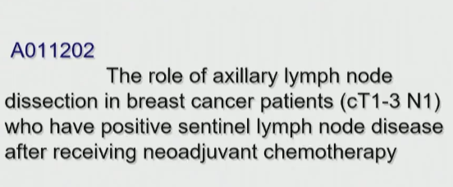

Slide 50
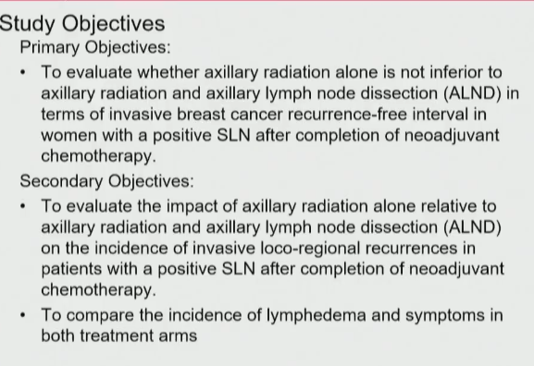

Slide 51
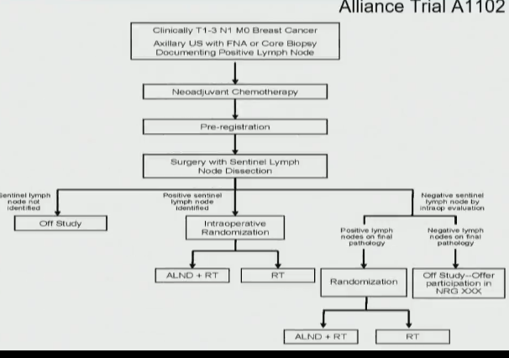

Slide 52
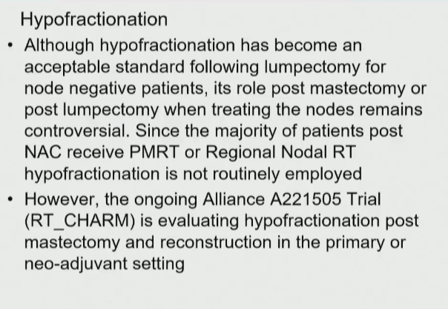

Slide 53
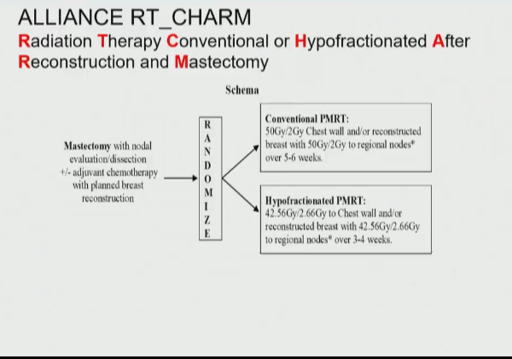

Slide 54
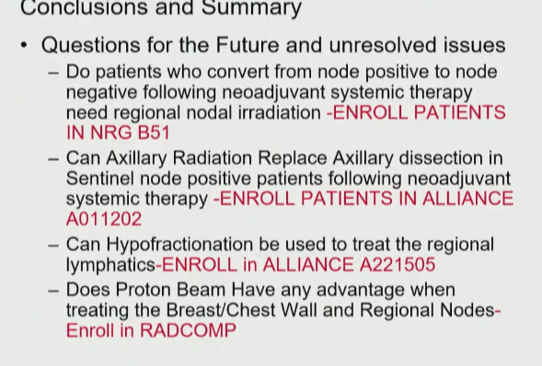

Slide 55
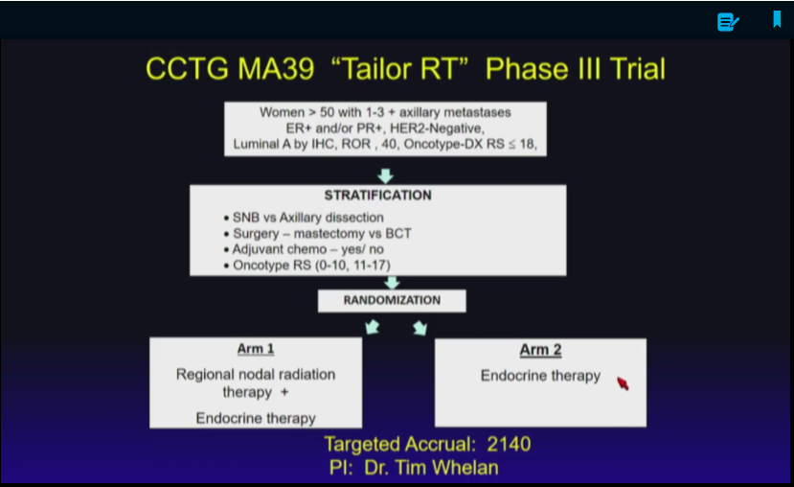

Slide 56
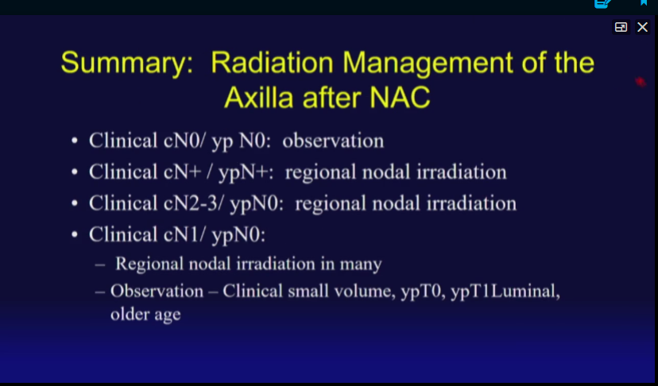

Slide 62
THAK YOU

